Slide 1
Oceanography of Coastal California
by
Sherry Palacios
sherry.l.palacios@nasa.gov
Notes:
Abstract: We live in a special place. Come learn about the physics, chemistry, and biology of the California Current System and what that means for diving along coastal California. Our special patch of the ocean, and a few others in the world, make up only 2% of the surface area, but account for 25% of the primary productivity. Find out why. Also, learn about kelp sex, roaming chemosynthetic clams, marine snow, the iron hypothesis, harmful algal blooms, seagrasses, the oceanographic seasons, water quality issues, and NASA's involvement in studying Monterey Bay. If there is time, and interest, I'll also talk about tides, my secret tide-pooling spots, and good restaurants for when the dive is blown-out. Send me mail directly if you want me to include the tide-slides in the talk (sherry.l.palacios@nasa.gov).
<number>

Slide 2
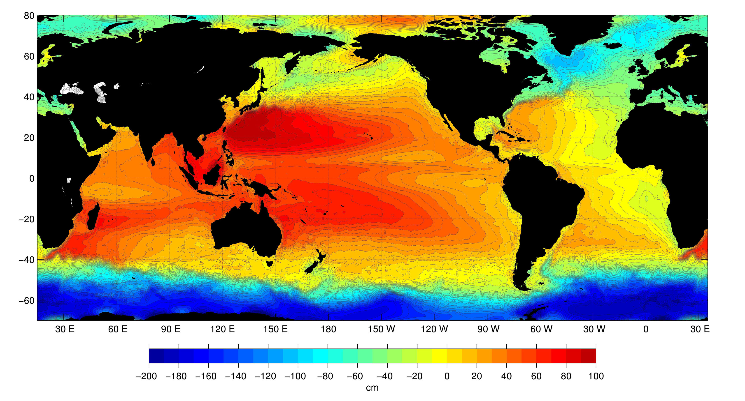
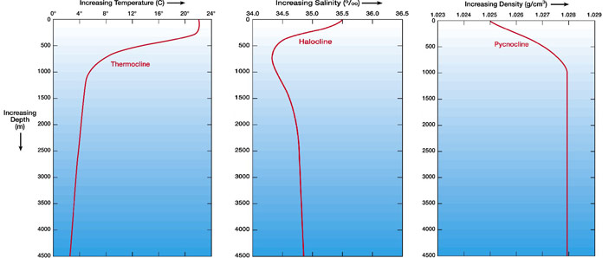
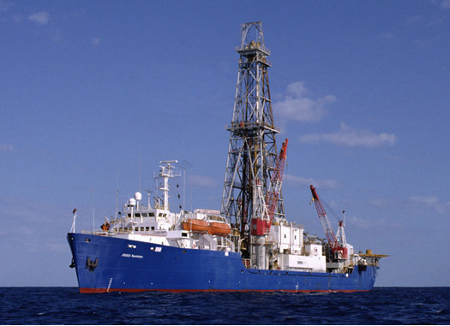
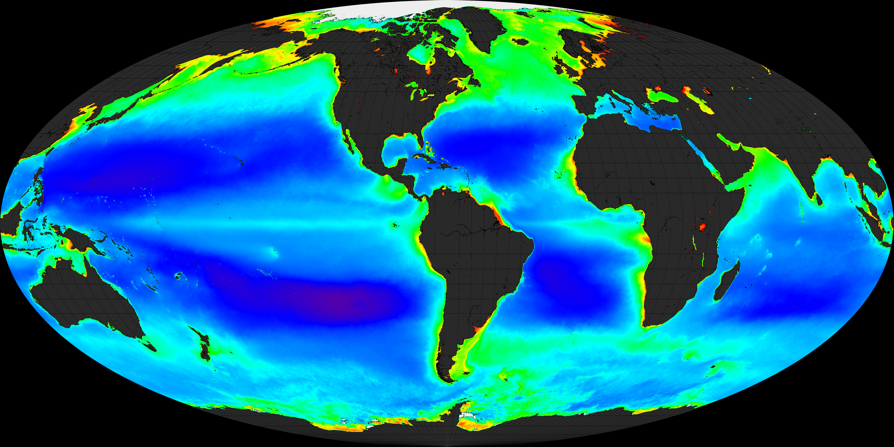
The Science of Oceanography
Physical
Chemical
Geological
Biological
Low
SeaWiFS chlorophyll-a average 1997 - 2003
High
Notes:
Oceanography – Physical, Chemical, Geological, Biological
<number>

Slide 3
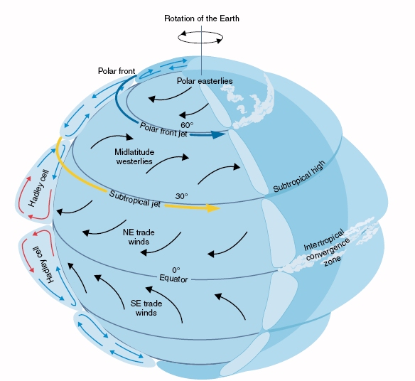
As Earth warms, winds develop and respond to the planet’s rotation (Coriolis)
Deflection is relative to
direction of flow...
Right in Northern Hemisphere
Left in Southern Hemisphere
Notes:
Winds and global physical forcing
<number>

Slide 4
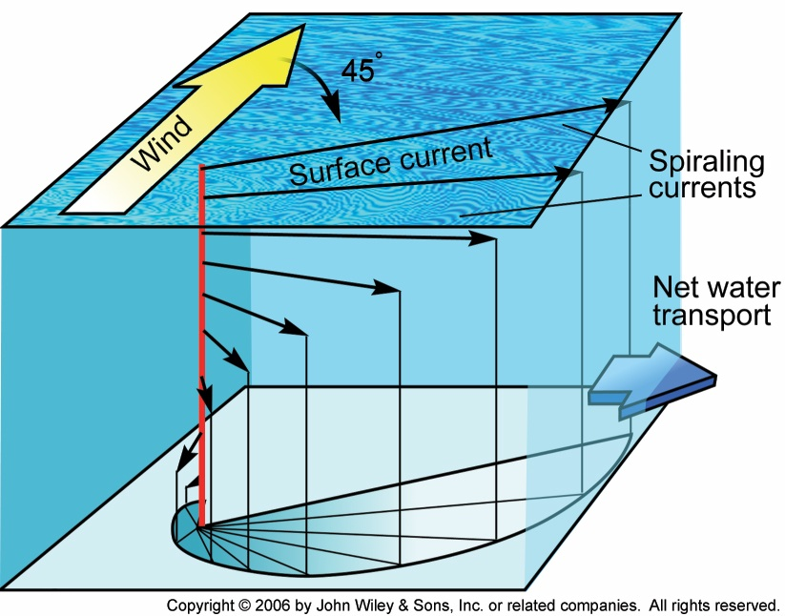
Wind energy is propagated into the water and drives water transport
‘Ekman Spiral’

Slide 5
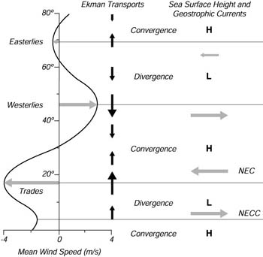
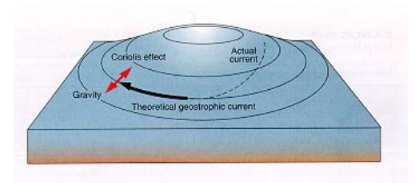
Global wind patterns, and the placement of continents help to form the geostrophic currents we know as ‘gyres’

Slide 6
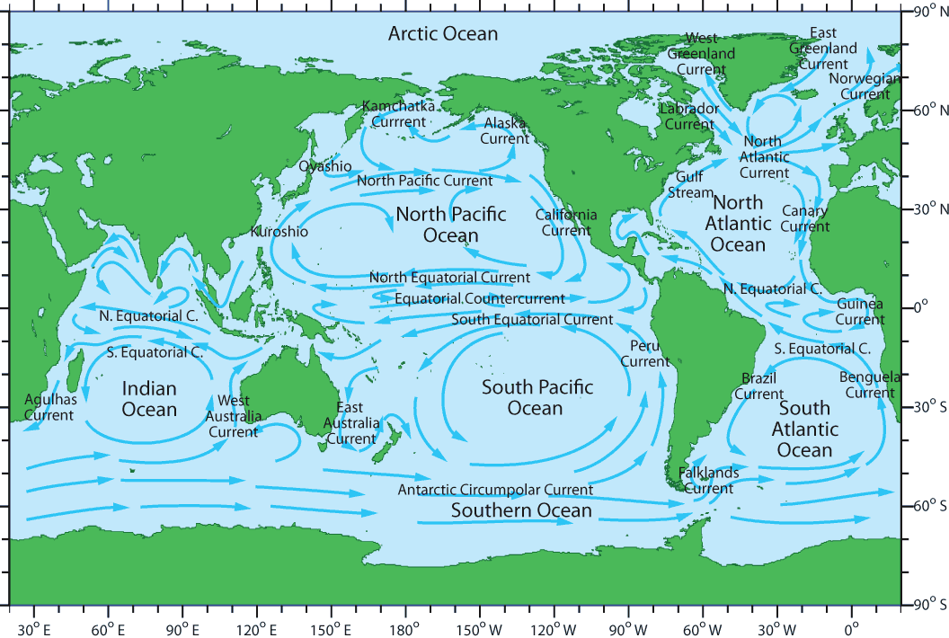
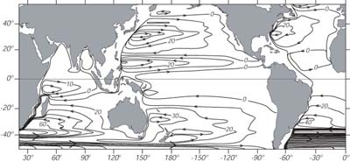
Global Ocean Currents
Some of the named currents
Friction with ocean
bathymetry causes these
gyres to be ‘off-center’,
also known as
‘Western Intensification’
Notes:
Global current systems – eastern and western boundary currents
<number>

Slide 7
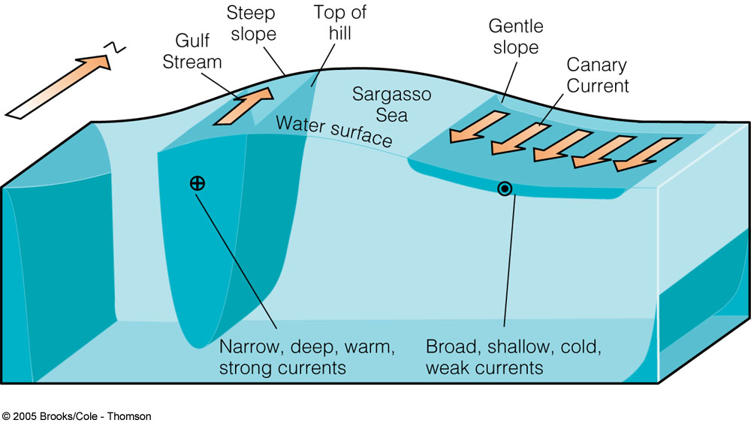
Western and Eastern Boundary Currents
e.g. California Current

Slide 8
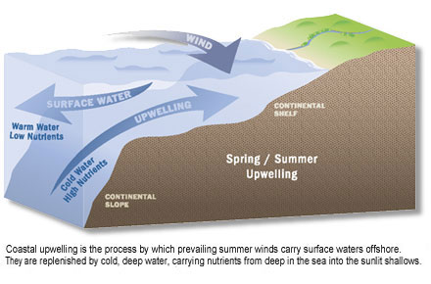
Coastal Wind-driven Upwelling

Slide 9
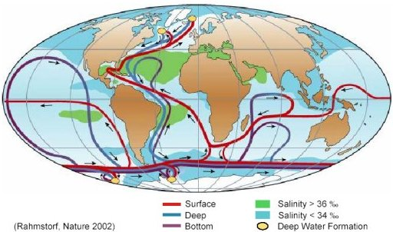
Ocean Chemistry
Meet the ‘Clines...
Temperature
Salinity
Density
Density structure of the
ocean drives
‘thermohaline circulation’
Notes:
ocean chemistry
<number>

Slide 10
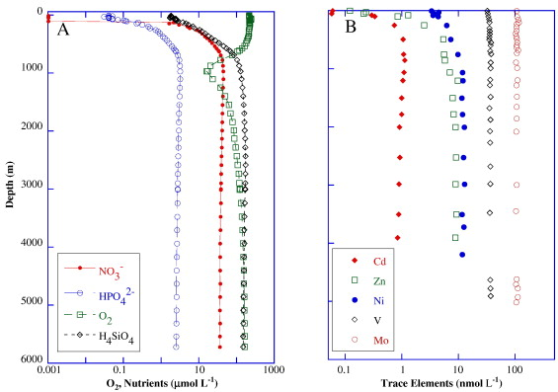
Nutrients important for primary production
Macro-nutrients: carbon, nitrogen, phosphorus, silica
Micro-nutrients: iron, manganese, zinc, cobalt
Redfield Ratio
C:N:P
106:16:1

Slide 11
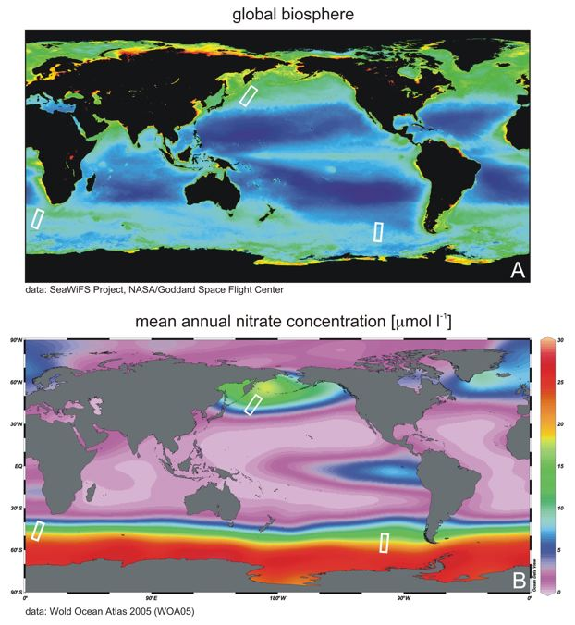
The Iron Hypothesis Give me a half tanker of iron and I’ll give you an ice age – John H. Martin
Notes:
iron hypothesis
<number>

Slide 12
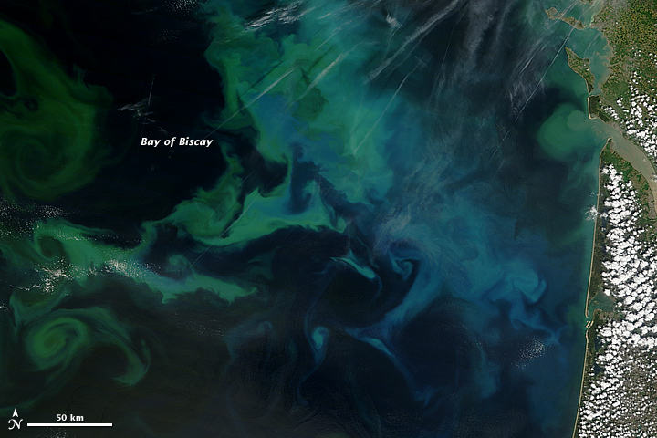
Ocean Biology
4 May 2013 - MODIS Terra
http://earthobservatory.nasa.gov/IOTD/view.php?id=81102&src=eoa-iotd

Slide 13
Factors that control phytoplankton biomass
Light
Nutrients
Temperature
Grazing

Slide 14
Our Oceanographic Seasons
‘Davidson’
‘Upwelling’
‘Oceanic’
Nov - Mar
Apr - Aug
Sept – Oct

Slide 15
Upwelling season is characterized by periods of wind and relaxation

Slide 16
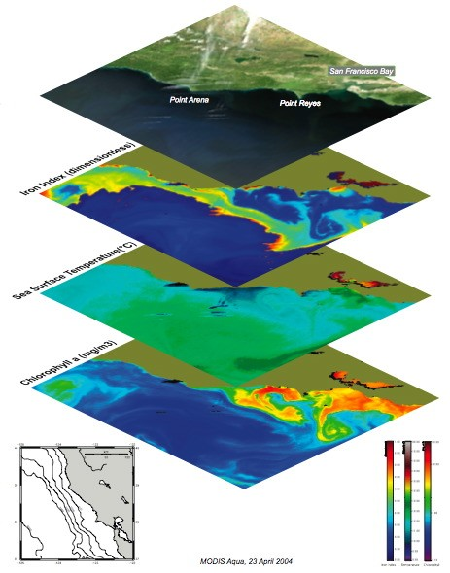
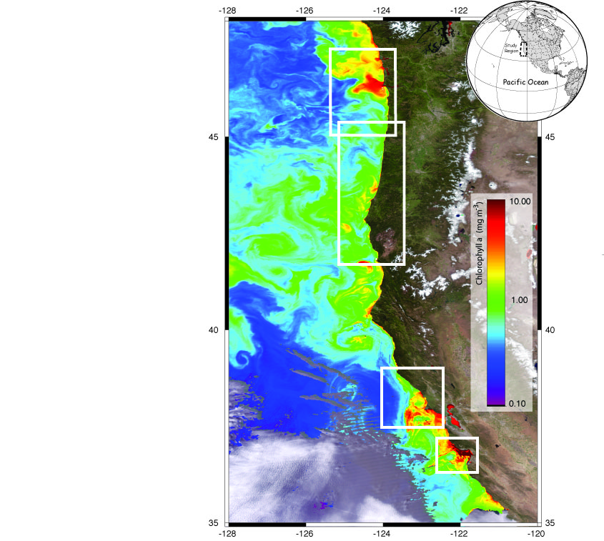
slide courtesy R. Kudela

Slide 17
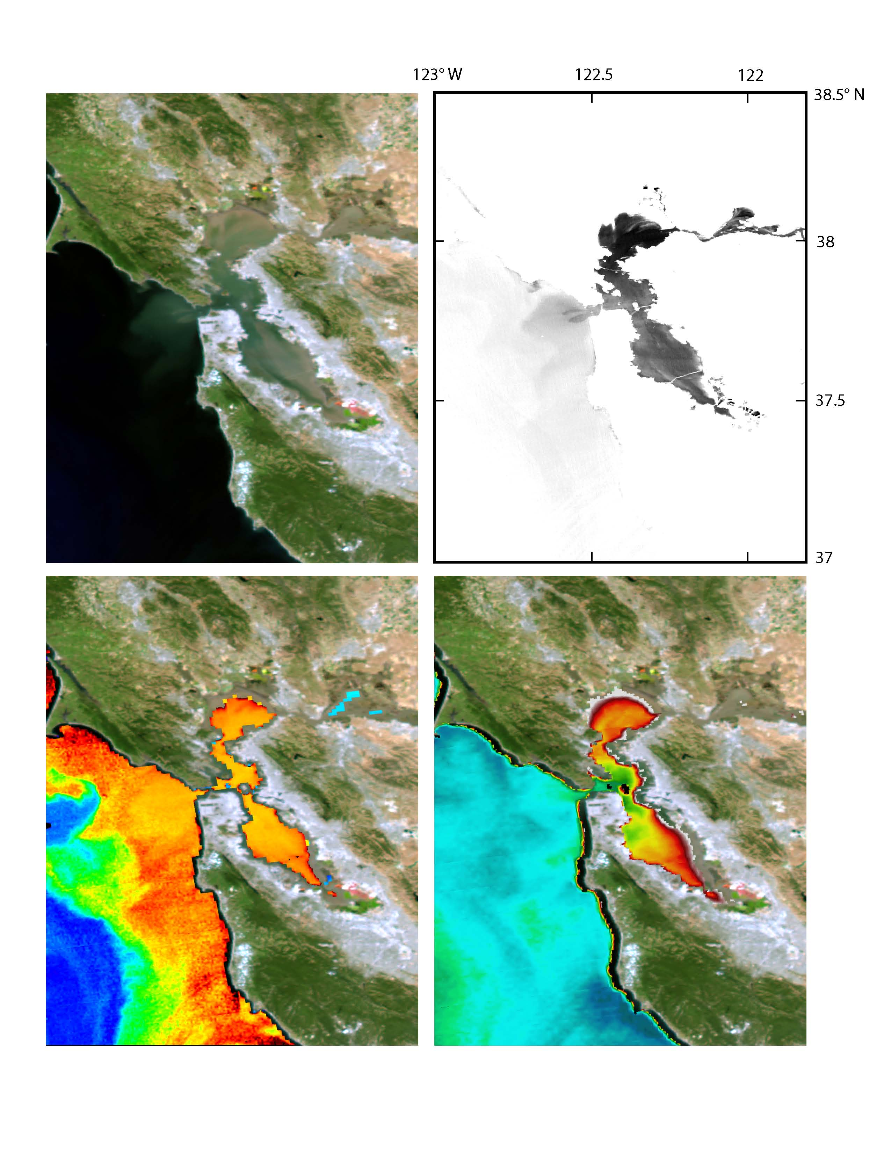
slide courtesy R. Kudela
True Color
Metals
Iron
Cobalt
Copper
Mercury
Methyl Mercury
Manganese
Nickel
Lead
Zinc
p<0.001
R2 from 0.52-0.91
Chlorophyll
SST
May 2004, MODIS

Slide 18
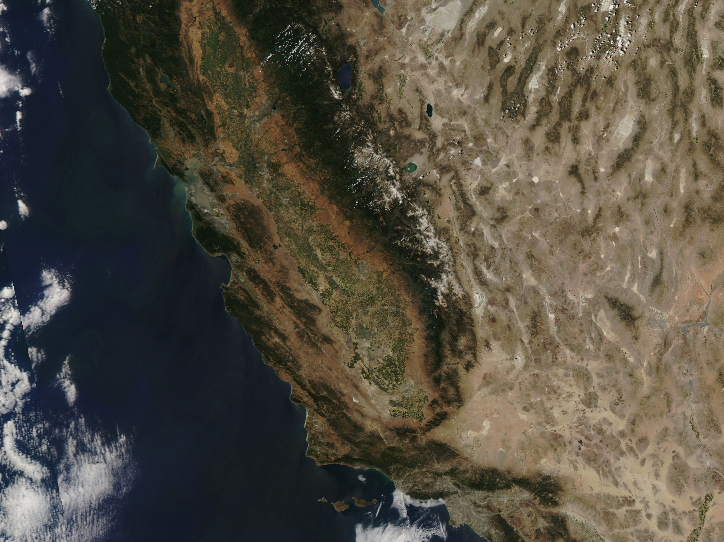
slide courtesy R. Kudela
MODIS Aqua, 8 June 2012

Slide 19
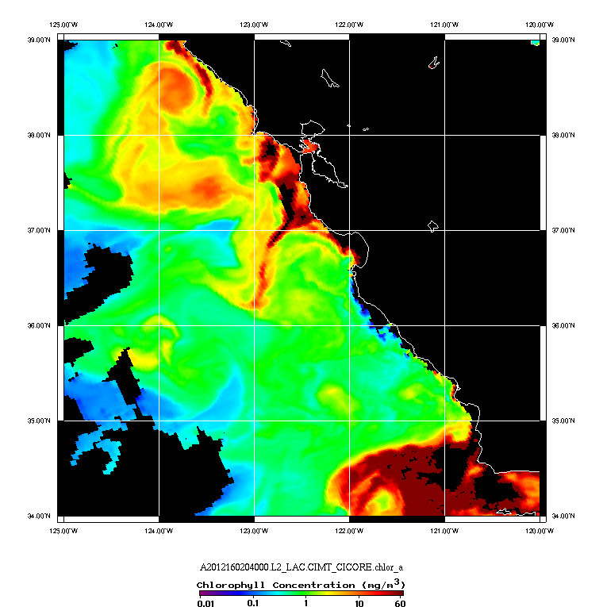
slide courtesy R. Kudela
MODIS Aqua, 8 June 2012

Slide 20
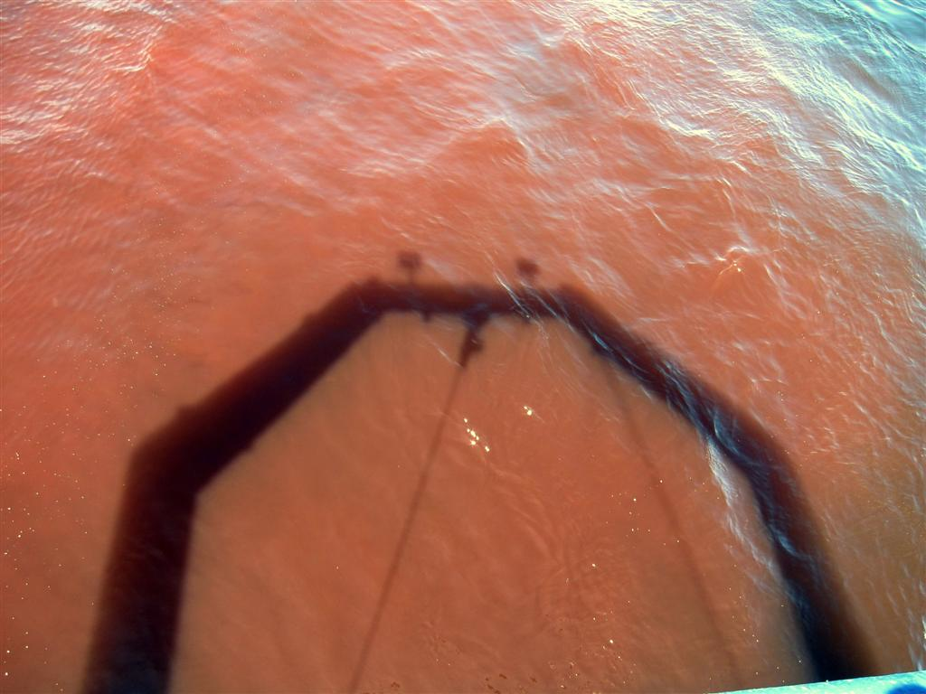
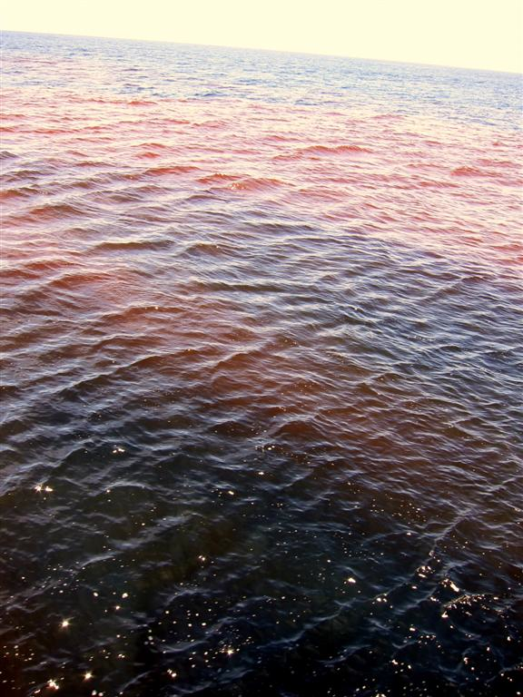
slide courtesy R. Kudela
Red Tide Event
Monterey Bay

Slide 21
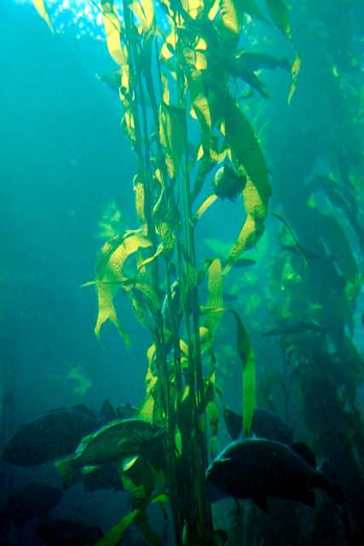
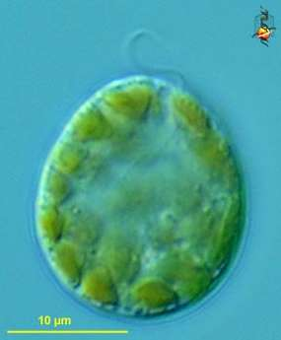
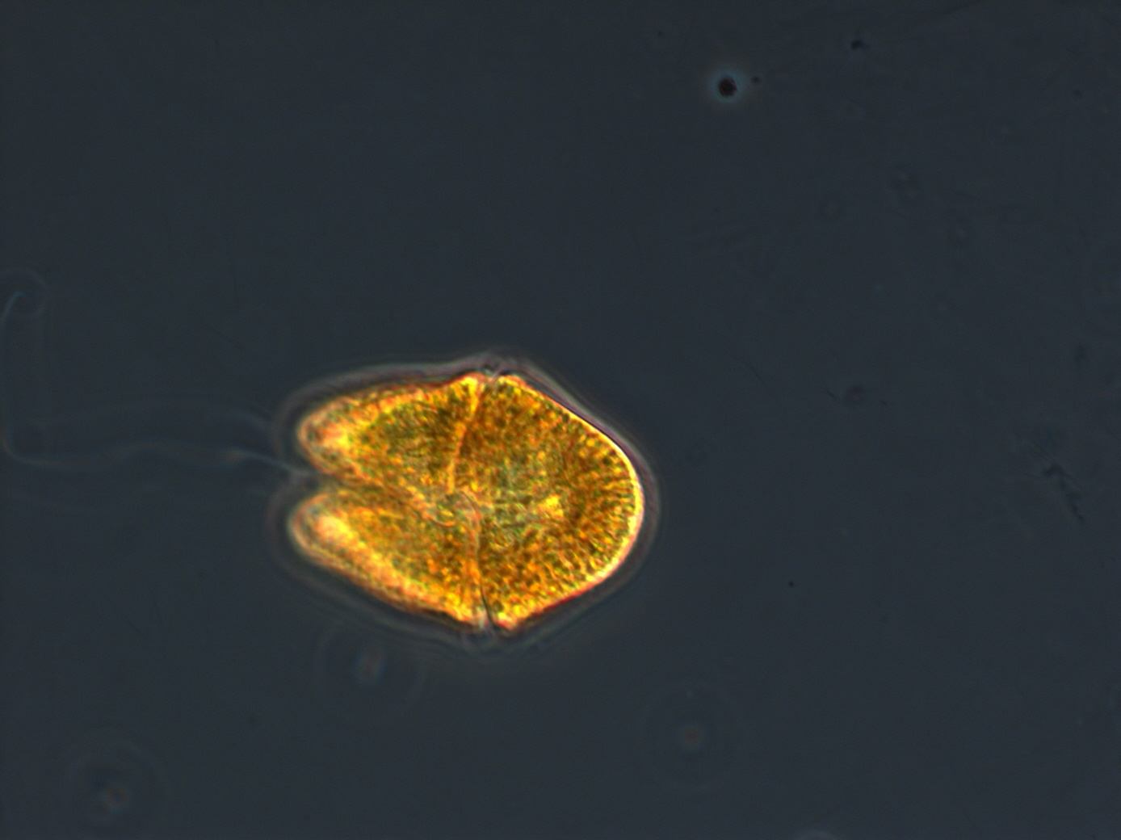
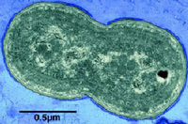
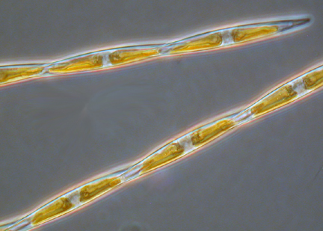
Algae can be single celled, chains of cells,
or larger macrophytes
R. Kudela
R. Jester

Slide 22
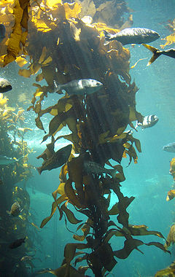
KELP FORESTS
All kelp forest ecology content
courtesy of Pete Raimondi, UCSC
Notes:
<number>

Slide 23
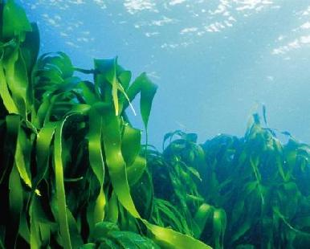
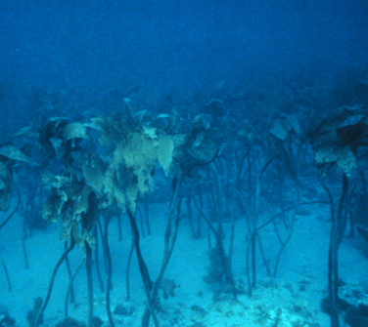
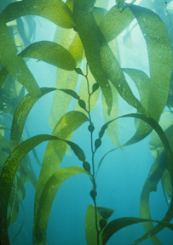
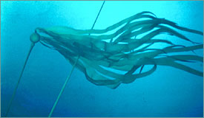
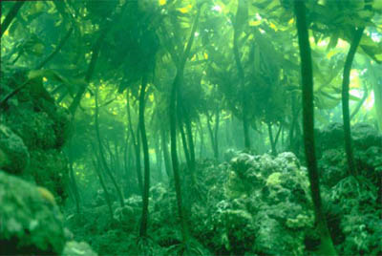
Distribution
Laminaria
Pterygophora
Types of kelp
Macrocystis
Ecklonia
Nereocystis
Notes:
<number>

Slide 24
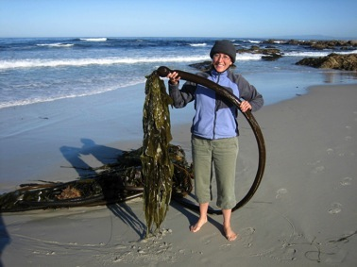
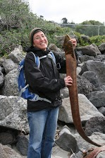
Christchurch, NZ
Durvillaea antarctica
“okay, I’ve seen what I wanted to see”
Pacific Grove – Asilomar, CA
Macrocystis pyrifera

Slide 25
Descriptive Ecology
Giant kelp
(Macrocystis pyrifera)
Occur on rocky bottoms (2 m to 30 m)
Competitive dominant alga
Northern limit set by hydrodynamic
forces
Southern limit set by poor substrate
& temperature/nutrients conditions
Notes:
<number>
- kelps = large brown algae in the order Laminariales
- 27 genera of kelp worldwide with varying morphologies,
- hierarchy of vegetation layers
• 4 genera produce floating canopies that extend from the bottom to the surface.
• others produce upright subsurface canopies (may or may not have floats)
• others produce bushy or prostrate canopies
• bottom layer under these kelp canopies consists of a variety of foliose & crustose understory algae and sessile suspension and filter feeding inverts
• -many species of fish and invertebrates use the 3d structure of kelp for:
• shelter from predators or excess water motion
• nursery habitat
• substrate
• food (direct and indirect consumption)
• food chain support

Slide 26
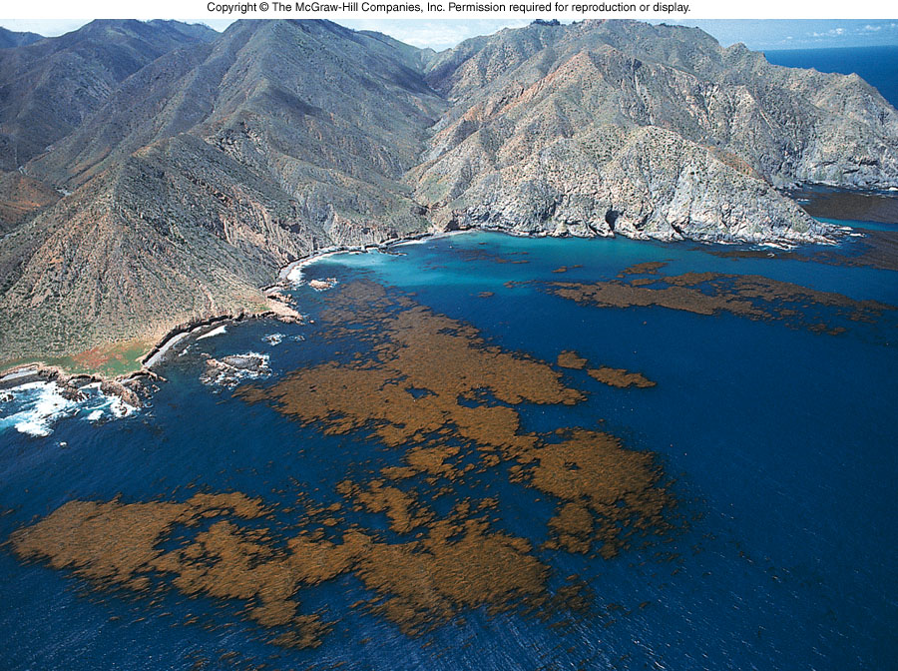
Distribution
Kelp forests - Where do they occur?
Notes:
<number>

Slide 27
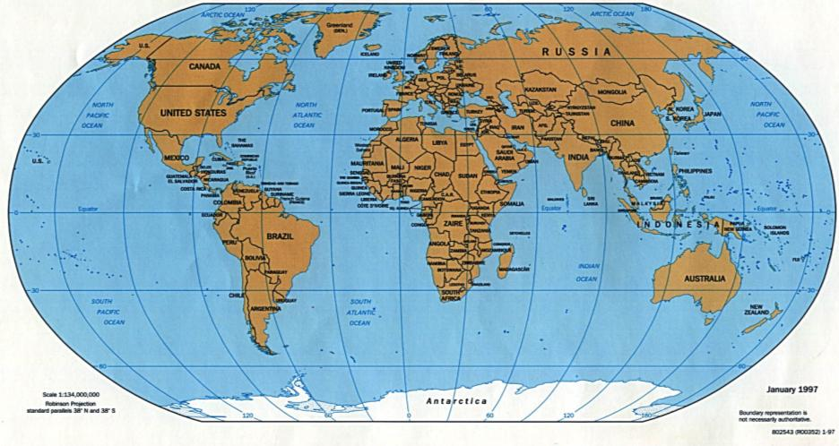
Laminaria
Macrocystis
and Nereocystis
Macrocystis
and Lessonia
Ecklonia and
Macrocystis
Macrocystis, Ecklonia and Laminaria
From: Steneck et al. 2002
Notes:
<number>

Slide 28
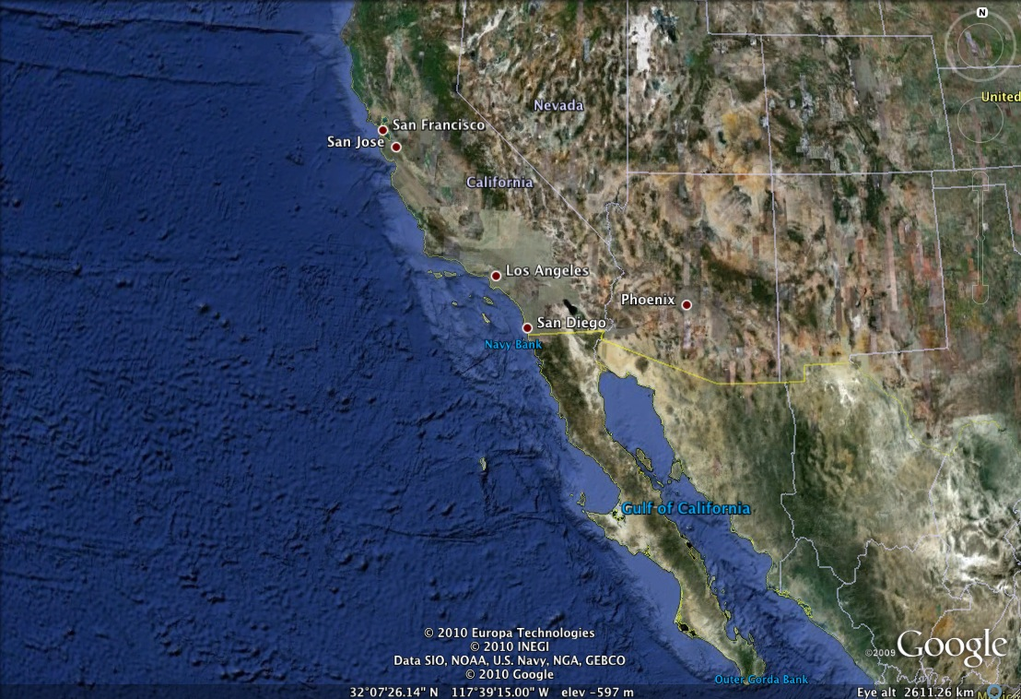
Distribution
Santa Cruz
Giant kelp’s range
~1450 km
Asunción
Notes:
Changes to nereocystis north of SF
<number>

Slide 29
Productivity
Kelp forests vs terrestrial forests
Notes:
<number>
Kelp forest structure similar to terrestrial forests – different canopy levels, varied understory
Kelp forests more productive, more diverse (phylogenetically)
Shorter life spans, shorter heights
Kelp forests reach 10-30 meters within 1-3 years, few sp. lasting more than 25 years
Terr. forests reach 10-30 meters within 20-30 years, living thousands of years
Recruitment and growth of new kelp depends upon canopy breaks for available light
Terrestrial forests are habitat for roughly 3 phyla
Kelp forests are habitat for 10 or more phyla

Slide 30
Productivity
Habitat Type | Annual Net Production (dry kg/m2/yr)
Tropical rain forest | 2.2
Tropical seasonal forest | 1.6
Temperate - evergreen forest | 1.3
- deciduous forest | 1.2
Boreal forest | 0.8
Giant kelp forest | 2.2
Estuary | 1.8
Upwelling zone | 0.5
Continental shelf | 0.36
Open Ocean | 0.13
Notes:
among the fastest growing plants in the world in either marine or terrestrial habitats. maximum elongation rates in the giant kelp Macrocystis pyrifera are on the order of 12 -18 inches per day
kelp forests are among the most productive communities in the world. Estimates of productivity comparable to tropical rain forests.
Interestingly, the biomass of the primary producers is two orders of magnitude less in the kelp forest. which really points to the high productivity of kelp relative to land plants
Only about 5-10 % of the primary production is consumed by grazers in either terrestrial or kelp forests.
In terrestrial forests most of the biomass accumates on the ground and persists as litter on the forest floor.
There is an order of magnitude less litter on the floor of a kelp forest compared to terrestrial forests
The reason is that in kelp forests most of the primary production is exported out of the forest by currents as floating mats on the surface or as detached fragments that drift along the bottom. Much of it ends up in deeper water, where it is consumed by organisms living below the photic zone. For example, research done in Monterey Submarine Canyon showed that a major component of the diet of deepwater sea urchins was kelp that had drifted into the canyon.
<number>

Slide 31
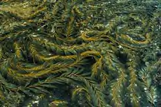
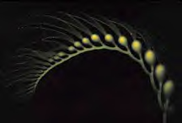
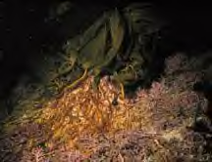
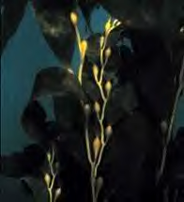
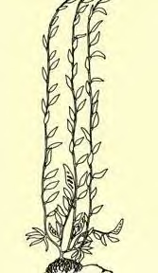
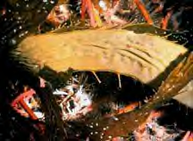
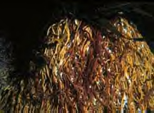
Morphology
Canopy
Blade
Sporophylls
Stipe
Sporophyll
Sorus
Holdfast
Notes:
<number>
Sporophylls = specialized blades at base of plant; the site of reproduction – spore production. Each sporophyll can contain billions of spores.
Sporangia are housed in the sorus

Slide 32
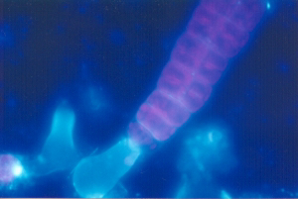
Kelp Reproduction
Reproduction
Complex life history alternating between multi-cellular haploid and diploid individuals
Very fecund – 10 trillion spores in lifetime!
High mortality of spores
baby sporophyte
Strongly influenced by temperature and availability of light, nutrients, and substrate
Lower depth limit is usually controlled by light
male
Gametophytes
female
Notes:
<number>
kelps are very fecund - A given plant can produce over 10 trillion spores during its relatively short lifetime, which for some species like the giant kelp is at most a couple years.
fertilization occurs after spores have dispersed and settled, which is very different from marine animals. This means that spores need to settle at relatively high densities in order to insure successful fertilization. The chance of this happening declines with dispersal distance due to the rapid dilution of spores following their release from the parent plant. The ecological consequence of this life history feature is that it constrains the distances over which spores can effectively colonize.
abiotic factors such as nutrients, temperature and light on growth and reproduction greatly affect life history stages. The production of gametes in the microscopic stage only occurs under certain conditions of light nutrients and temperature.
This is particually important when you think about the habitat that kelp plants recruit to. They start life as a microscopic cell on the bottom not at the surface. It turns out that in most cases the lower depth limit of kelp is determined by the amount of light reaching small stages on the bottom. It has been estimated that the depth that this occurs is where light is reduced to » 1% of that at the waters surface.

Slide 33
Macrocystis life cycle
Notes:
<number>

Slide 34
Kelp forests come and go…
Notes:
<number>
Kelp forests can disappear quickly
-- temperature changes
-- severe storms
-- outbreaks of herbivorous invertebrates
-- disease
However, the kelp forest community can regrow just as quickly

Slide 35
Abiotic factors influencing distribution and abundance
Nutrients
Temperature
Light
Water motion
Hard substrate
Notes:
Nutrients- plants obviously need nutrients to grow and reproduce. Concentrations of nitrogen and phosphorus vary spatially and temporally in coastal waters. In California, nutrient concentrations generally greater in the north than in the south. They typically peak in the spring when most upwelling occurs and are at a low in the fall. Nutrient concentrations can vary greatly from year to year owing to oceanographic events such as El Nino during which time they tend be in very short supply.
Temperature- primarily cool water plants. The effects of temperature are difficult to assess in nature because in many temperate areas where kelp grows temperature covaries inversely with nutrient concentration. In southern California kelp growth is extremely seasonal: greatest in spring when temperatures typically are low and nutrients are high and lowest in the late summer and fall when sea water temperatures are high and nutrient concentrations are low. Such seasonal variation can disappear during prolonged periods of high temperature and low nutrients such as that that occurs during El Niños. Under these conditions growth and reproduction remains low year round and in the most severe cases results in death
Light – essential for growth and reproduction
Provides energy for photosynthesis
Influenced by depth, water clarity, season, latitude, vegetation shading
Most severe in early life history stages and transitions (spore, gametophyte, fertilization, sporophyte
Water Motion
The concentration of nutrients is not the only thing that affects nutrient absorption in kelp. For example, in calm conditions growth can be limited by nutrients even in relatively nutrient rich waters. This is because nutrients can become locally depleted near the surface of plant tissues in still water. Water motion prevents this from happening by maintaining a constant flux of nutrients across the tissues of the plant.
Too much water motion, however, is not good. it can dislodge plants from the bottom, then they end up on the beach or get transported offshore where they die.
There is a tradeoff in being large. Light vs Drag
While light may set the lower depth limit for kelp, water motion is believed to be important in determining the upper limit for many species.
High water motion associated with storms is extremely important source of disturbance in kelp communities and can have a profound effect on the spatial and temporal dynamics of kelp populations. Severe storms such as the ones that occurred during the 1982-83 El Niño can completely destroy entire populations of kelp.
<number>

Slide 36
Abiotic Factors
1982-83 El Niño
Wave Action
Notes:
<number>

Slide 37
Biotic factors influencing distribution and abundance
Spore dispersal
Competition (especially for substrate)
Grazing
Notes:
Dispersal
Kelp populations are very dynamic and frequently undergo local extinctions and recolonizations.
Dispersal is a key element to the recolonization process.
Historically spore dispersal in kelps has been thought to be limited to within a few meters of the parent plant. Such limited dispersal, however, cannot account for the rapid and widespread recolonization of kelps that is frequently observed.
Spore dispersal in kelps may not be limited to a few meters.
We have measured spore dispersal over distances as large as several kilometers.
Large storms
Turbulent flow
Storms also cause massive release of spores
Together – release and dispersal during storms leads to long distance dispersal
What else??
Competition
Competition between different vegetation layers can be important in structuring kelp populations. Most the work that has been done has focused on adults inhibiting juveniles. In general the recruitment of nearly all algae is suppressed underneath dense kelp canopies. Light reduction to 1%
Hormonal trickery
Layering - Given this high level of shading it is not surprising that there is strong competition for light among the different vegetation layers.
There has also been much work done on the effects of intraspecific competition. In general, kelps tend to grow larger, live longer, and produce more spores in lower density stands, though there are some exceptions to this pattern.
Grazing
Clearly the number one enemy of kelp are sea urchins. They are the single most important grazer in kelp communities worldwide. They can form large feeding fronts and eat everything in sight (including fiberglass transect tapes), essentially leaving behind a barren ground devoid of macro algae.
Urchins don’t always display an active grazing behavior. They are typically sit and wait herbivores much like abalone that catch detached pieces of kelp as they drift by.
The single most effective predator on sea urchins are sea otters which once ranged from the Kuril Islands in Japan through the Aleutian Is and down the coast of North America to Baja California. Otters eat ≈ 25 % οφ τηειρ βοδψ ωειγητ περ δαψ ανδ χαν εφφεχτιϖελψ ελιμινατε λοχαλ ποπυλατιονσ οφ σεα υρχηινσ ανδ οτηερ σηελλφιση.
Islands with sea otters had low densities of urchins and densely vegetated kelp beds. In contrast, islands without sea otters are basically unvegetated barren areas with have high densities of urchins and no macro algae. Thus sea otters have been given this keystone status. The paradigm is that where there are otters you get kelp beds where there is no otters you get sea urchin barren grounds. This paradigm seems to apply generally in Alaska.
<number>

Slide 38
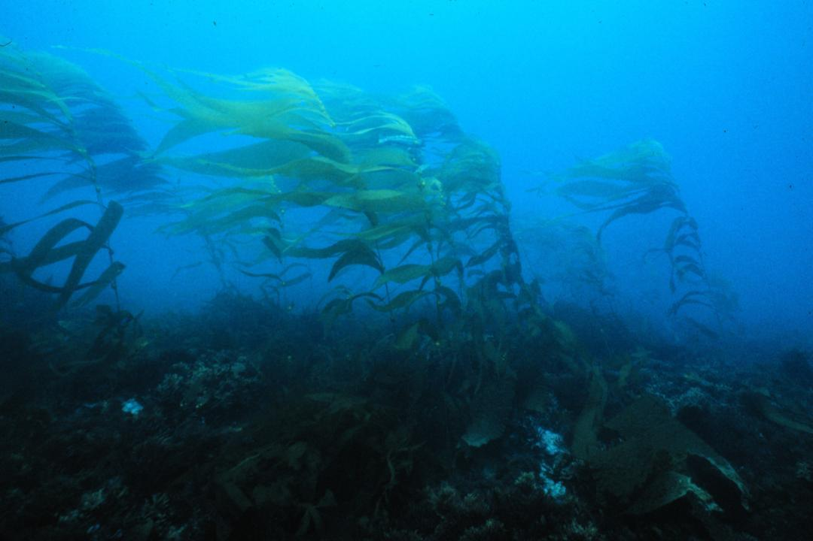
Biotic Factors
Competition for space
Notes:
<number>

Slide 39
Biotic Factors
Sea urchins graze on kelp
grazers

Slide 40
Biotic Factors
Sea otters control urchin populations by eating them
Otters- cute killers
Notes:
<number>
Kelp forest habitat determined by urchin abundance
Urchin abundance determined by various factors:
Predation (ex. Otters, fish -- most important factor), interspecific competition (other herbivores, i.e. abalone), disease, turbulence, storms, etc.

Slide 41
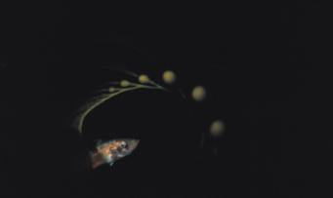
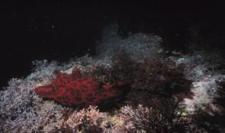
Giant kelp communities
Juvenile finfish
Invertebrates
Understory algae
Invertebrates
Adult finfish
Marine mammals

Slide 42
Some other interesting topics...

Slide 43
Marine Snow
Notes:
marine snow is a continuous shower of mostly organic detritus falling from the upper layers of the water column. It is a significant means of exporting energy from the light-rich photic zone to the aphotic zone below.
<number>

Slide 44
Wandering Chemosynthetic Clams
Calyptogena
Notes:
Figure 1. Locations of Monterey Bay Aquarium Research Institute’s benthic re- motely operated vehicle (ROV) dive tracks (blue) and sites where video annota- tions indicate occurrence of chemosynthetic biological communities (CBCs): seeps, vesicomyid clams, vestimentiferan worms, or bacterial mats (red), and au- thigenic carbonates (green) occur. Background is seafloor rugosity image based on multibeam bathymetry with 200 m, 1000 m, and 2000 m contours. Fault traces are from Greene (1977). Also shown are epicenters of earthquakes of magnitude 2 or higher since February 1967 (www.quake.geo.berkeley.edu). CA—California.
<number>

Slide 45
Tides – Gravitational Theory

Slide 46
Tides – Dynamical Theory

Slide 47
Types of Tides

Slide 48
My favorite tide-pooling spots
Pigeon Point Lighthouse
Coral St., Pacific Grove
Tide Apps:
MultiTide and ShralpTide
18th Tee, Pebble Beach

Slide 49
Aquatic Distractions
Planning your dive:
http://www.garlic.com/~triblet/swell/wamglance.html
Learning about the ocean:
http://www.cencoos.org/
http://www.sccoos.org/index.html
Playing with data:
http://coastwatch.pfeg.noaa.gov/coastwatch/CWBrowser.jsp
marinexplore.org

Slide 50
Dive is blown out?
Local Academic Seminars:
UCSC Ocean Sciences – Fridays at noon
http://oceansci.ucsc.edu/seminars/index.html
MLML – Fridays at 4pm
http://www.mlml.calstate.edu/announcements/seminars
MBARI – Wednesdays at 3pm
http://www.mbari.org/seminars/
Hopkins Marine Station – Fridays at noon
http://www-marine.stanford.edu/index.html
Schedules vary and there are often gaps, so check websites
Notes:
<number>

Slide 51
Dive is blown out?
Local Activities:
Monterey Bay Aquarium
Elkhorn Slough Visitors Center and hiking trails
Seymour Center at Long Marine Lab
Pacific Grove Museum of Natural History
Steinbeck Center (Salinas)
Soquel Vineyards (weekends, 11-4)
Notes:
<number>

Slide 52
Dive is blown out?
Restaurants:
Monterey area: Sea Harvest, Monterey Fish House, Il Vechio, Tillie Gort’s Cafe, Turtle Bay Taqueria
Moss Landing: Haute Enchilada, Sea Harvest
Capitola: Gayles Bakery
Santa Cruz: Silver Spur Restaurant (breakfast), Kelly’s Bakery, Santa Cruz Mountain Brewing, Lillian’s Italian Kitchen, Engfer Pizza Works, AsianRose/IndiaJoze/Malabar (Front St.), Charlie Hong Kong
Notes:
<number>

Slide 53
The sea, once it casts its spell, holds one in its net of wonder forever. - Jacques Cousteau
Notes:
Breathe
<number>

Slide 54
Extra Stuff

Slide 55
The Big Picture
June 24, 2013
398.77 ppm
http://keelingcurve.ucsd.edu/

Slide 56
What are the different “types” of elements?

Slide 57
Classification of elements
Conservative
(or “bio-unlimited”)
Bio-limiting
(and “biointermediate”)
Scavenged
Some have a style of their own (e.g. O, Ar, Bi, Hg)

